Slide 1


AR
Riddles

Slide 2
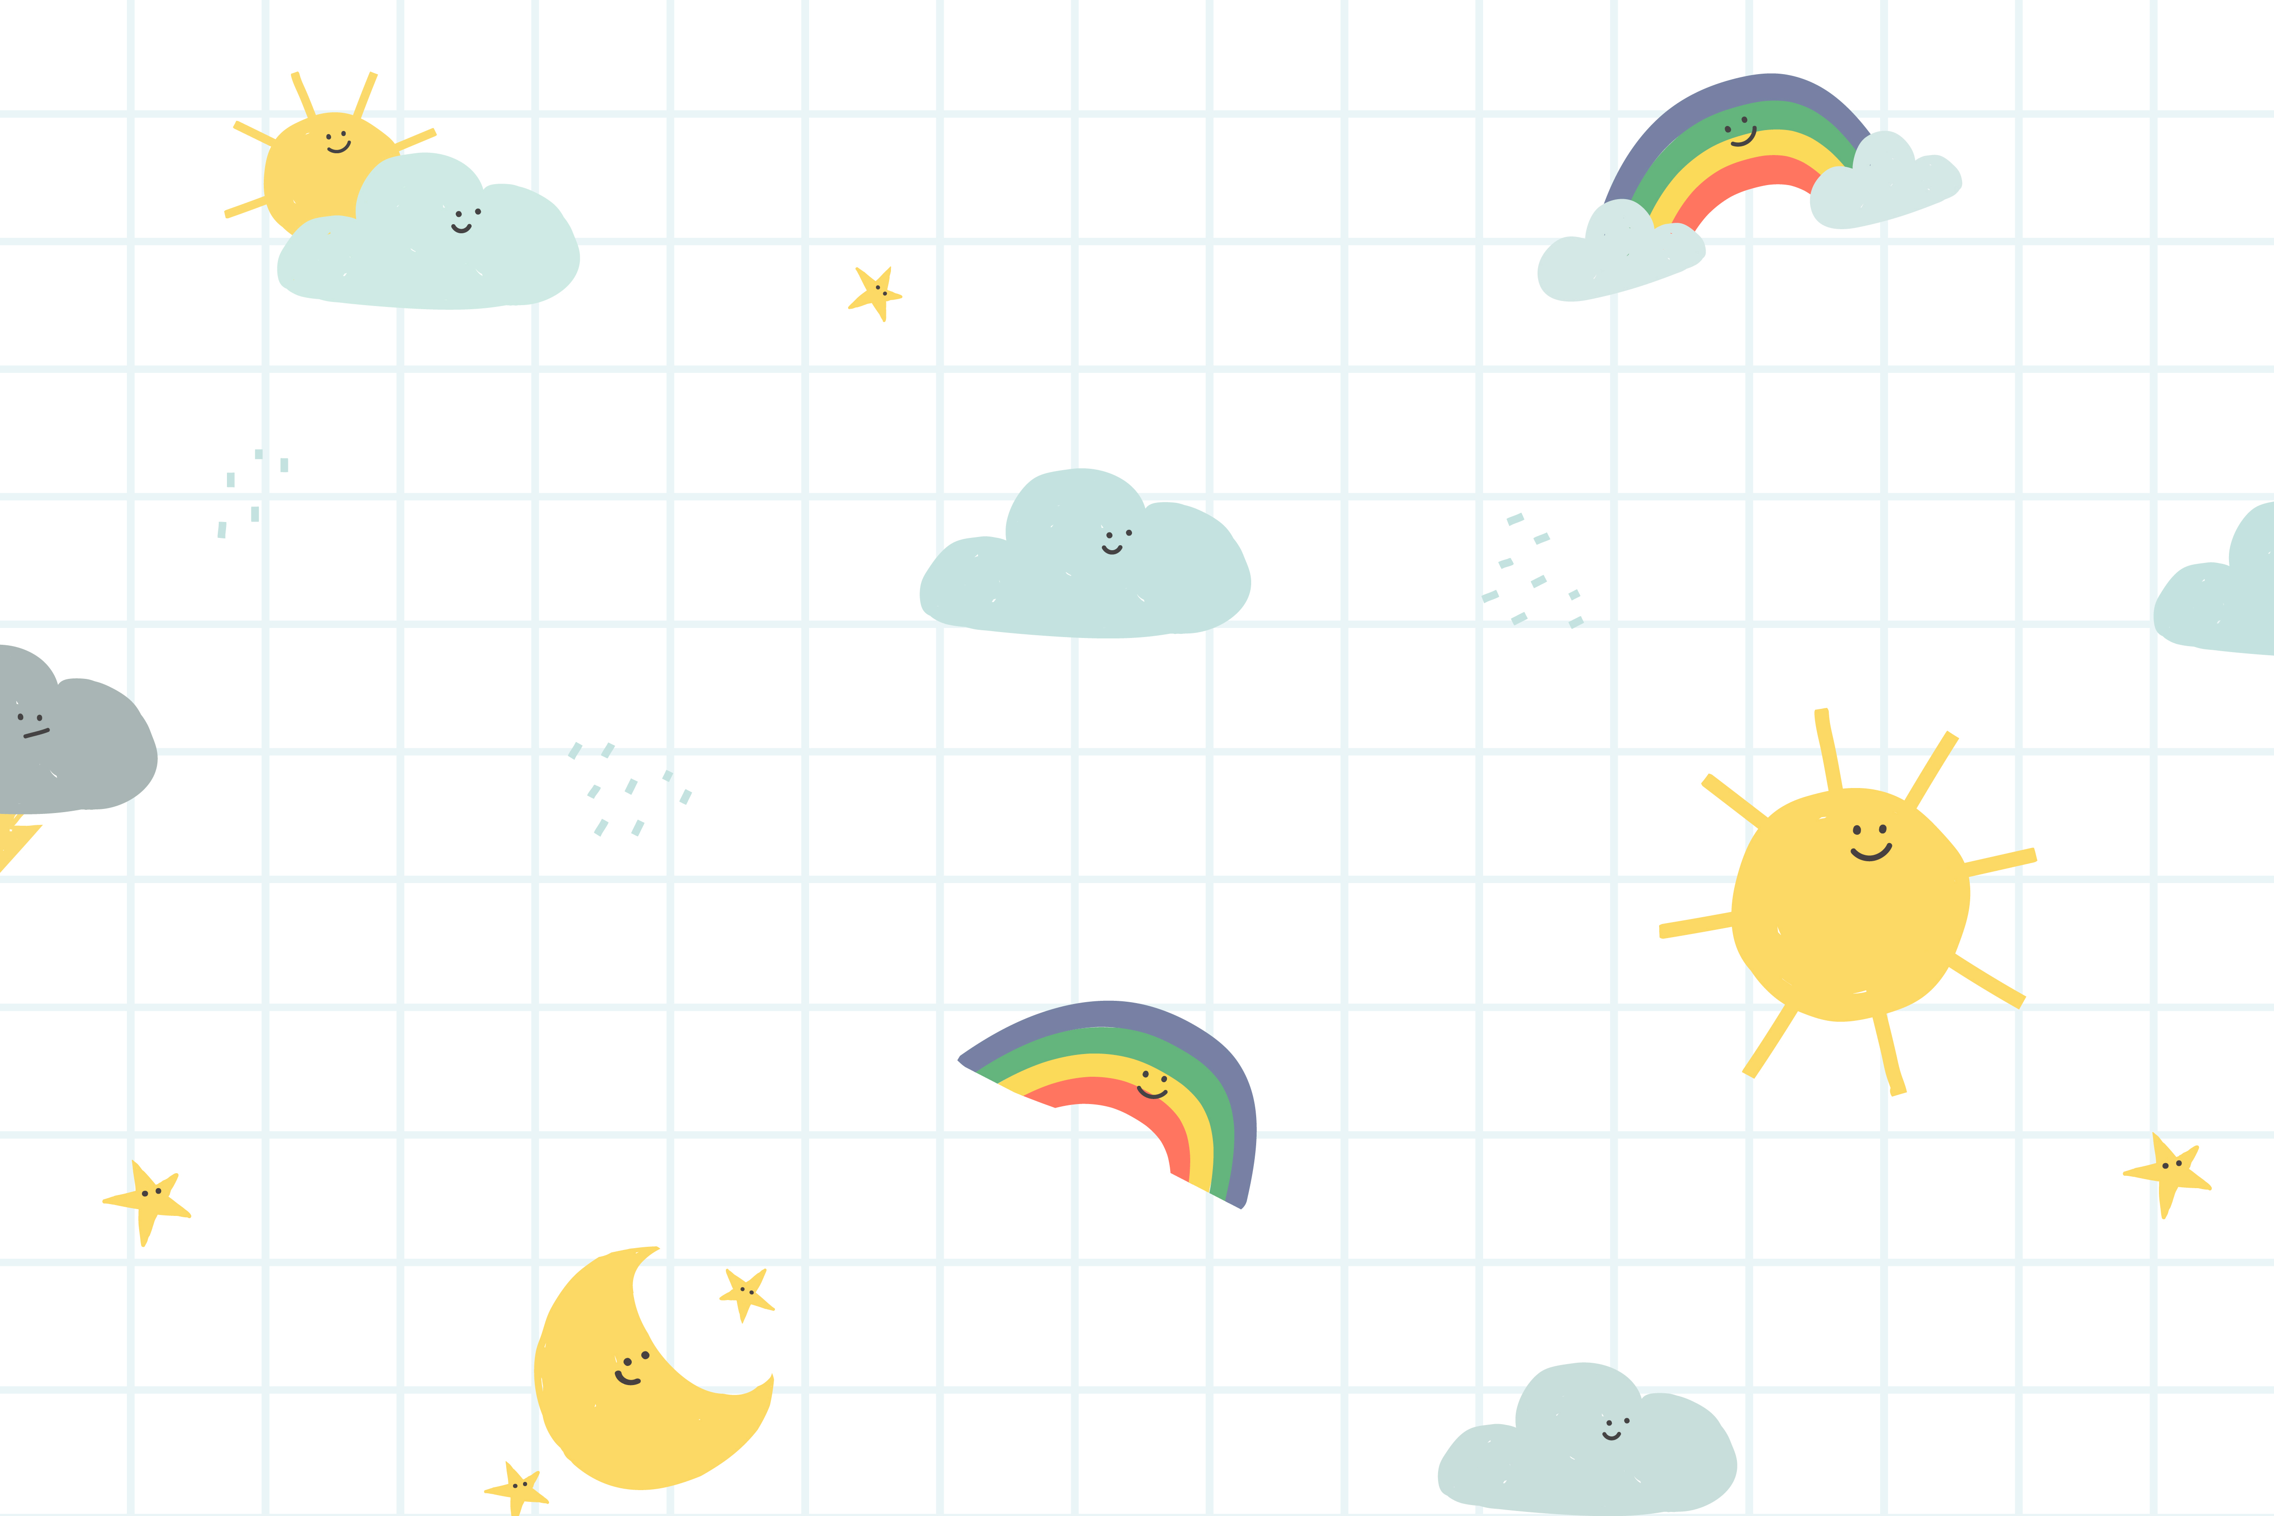
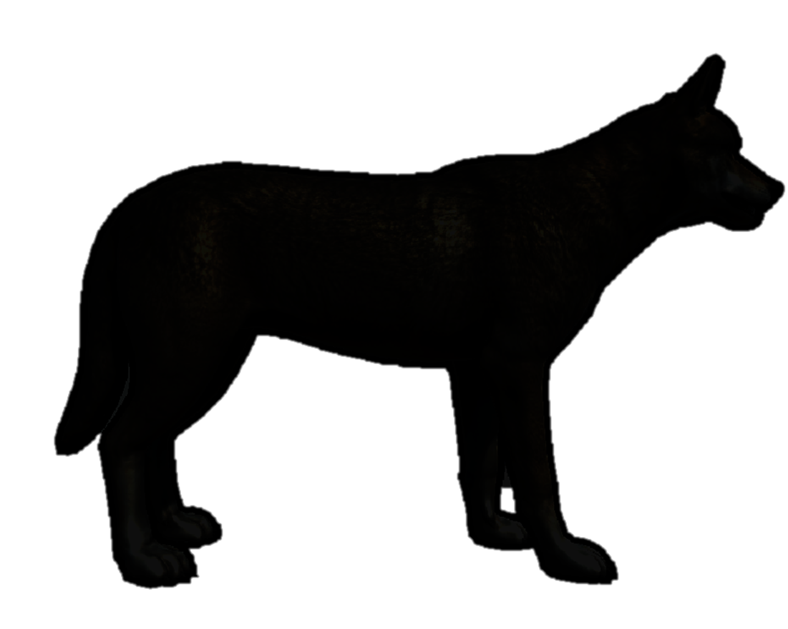
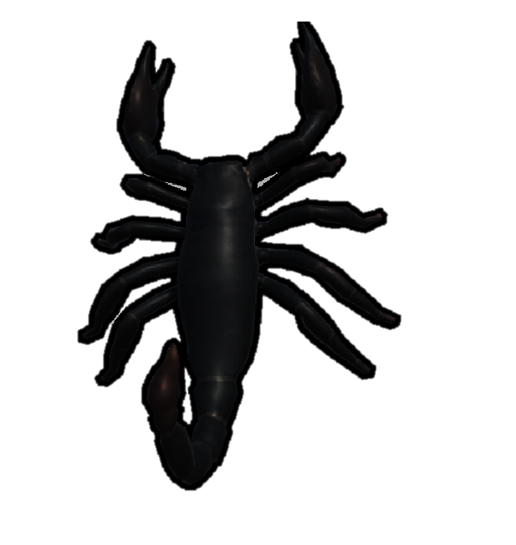

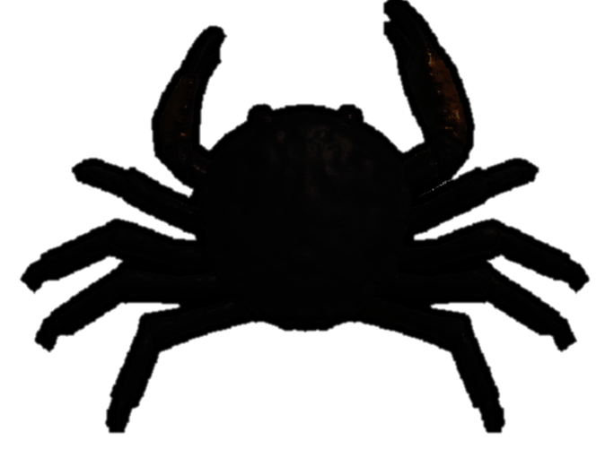


Guess
Who am I?

Slide 3

I have flattened body
My name starts with the letter C
I walk sideways
I have ten legs
Notes:
https://nodeestep.blogspot.com/2021/05/guessing-for-kids-who-am-i-i-am-crab.html

Slide 4
I have a pair of pincers.
I have a hard exoskeleton!
I have eight legs.
My name starts with the letter S.
Notes:
https://nodeestep.blogspot.com/2021/09/guessing-for-kids-who-am-i-i-am-scorpion.html

Slide 5
My name starts with the letter S.
My eyes on the tips of my tentacles
I carry my shell on my back!
I don‘t have a backbone.
Notes:
https://nodeestep.blogspot.com/2021/09/guessing-for-kids-who-am-i-i-am-snail.html

Slide 6
My name starts with the letter W.
I have gray and brown fur!
I have a bushy tail.
I make a howl sound.
Notes:
https://nodeestep.blogspot.com/2021/09/guessing-for-kids-who-am-i-i-am-wolf.html

Slide 7
My name starts with the letter R
I have long ears
I have a short fluffy tail
I am a good jumper
Notes:
https://nodeestep.blogspot.com/2021/09/guessing-for-kids-who-am-i-i-am-rabbit.html

Slide 8
My name starts with the letter G
I can swim
I have gray feathers

